Slide 1


Discover the Historical Munich Bridges through a Gamified Mobile Walk
Citizen-centered disaster preparedness
Zsolt László Márkus, György Szántó, Tibor Szkaliczki, Miklós Veres, Zsolt Weisz
eLearning Department of the HUN-REN Institute for Computer Science and Control (HUN-REN SZTAKI)
Sean Klein, Jane Jean Kiam
Institute for Flight Systems, University of the Bundeswehr Munich, Germany
DiPP 2026 Conference

Slide 2
Contents
B-prepared Horizon project
IM-prepared mobile application
Munich’s Thematic Heritage Sites along the river Isar
Gamified Mobile Walk in Munich
Evaluation
Conclusions

Slide 3
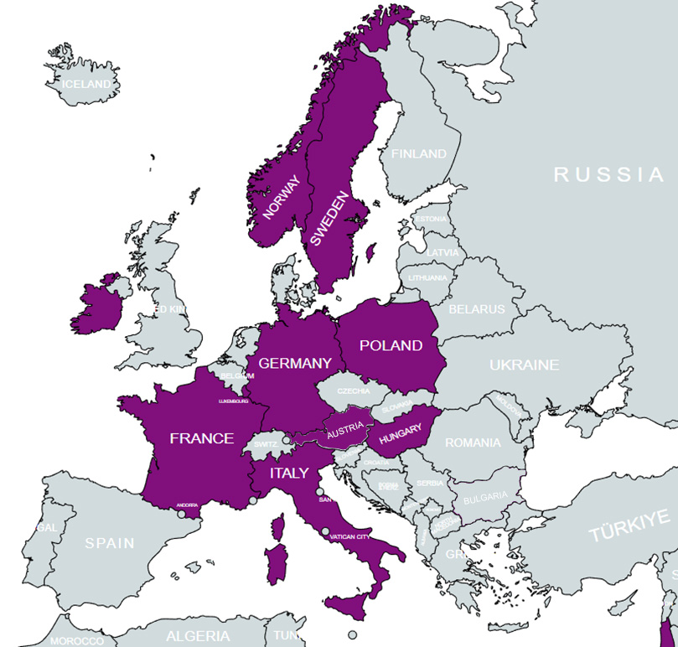

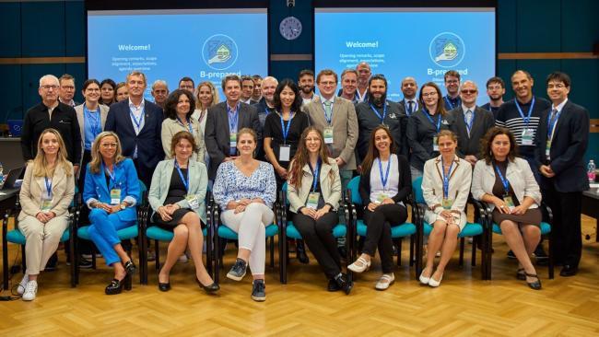
Building PREPAREDness with Collaborative Knowledge Platform, Gamification and Serious Game in Virtual Reality
A consortium of 15 partners from 11 EU Member States and associated countries across Europe.

Slide 4
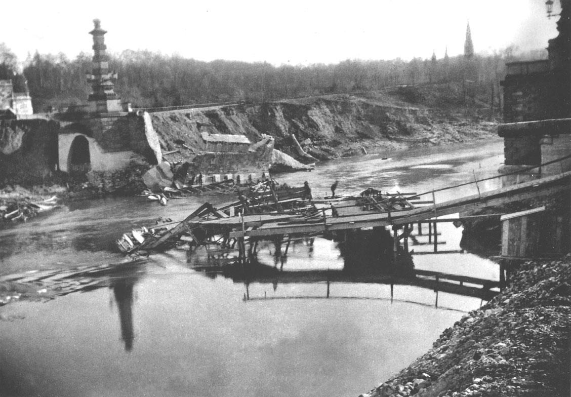

Why B-prepared?
Even the most advanced alert systems and first responder organisations cannot entirely avert fatalities and property damage.
It's crucial to empower citizens with the knowledge and skills needed to act and react effectively during disaster situations and crises, comprehend alerts, and follow instructions.
PLAN A IS THAT FIRST AND SECOND RESPONDERS ARE COMING TO HELP YOU.
UNTIL THEN, YOU NEED TO HAVE A PLAN B.

Slide 5
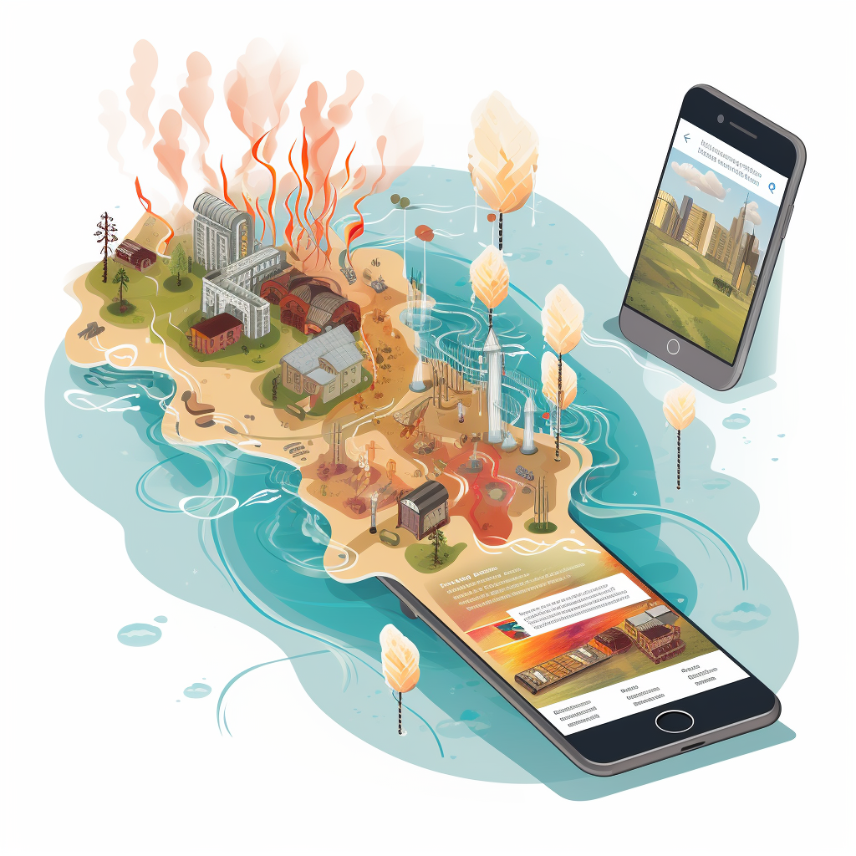
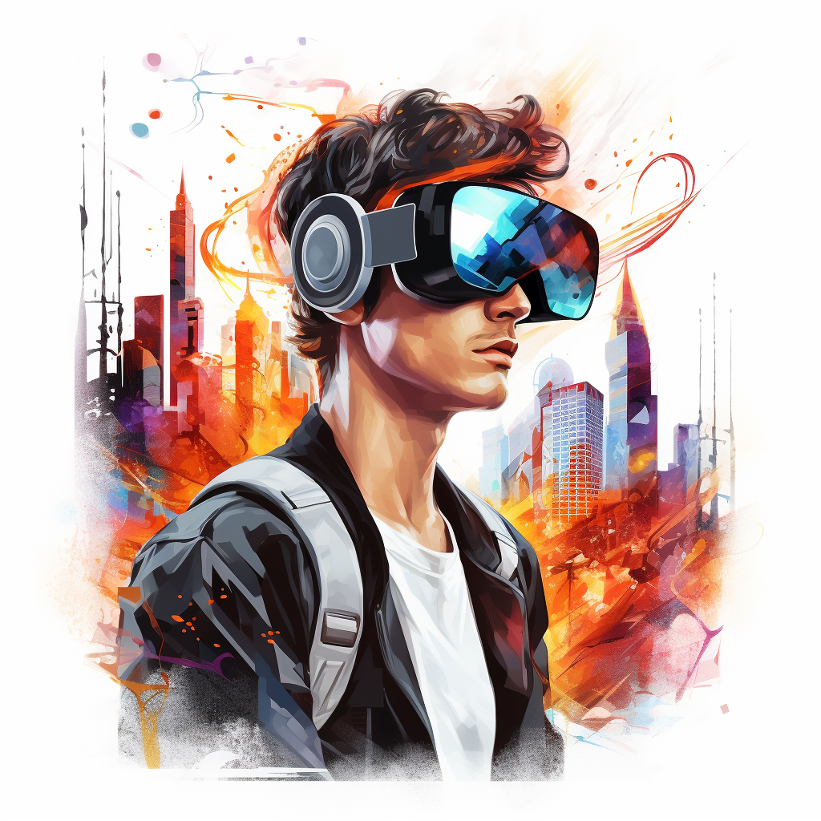
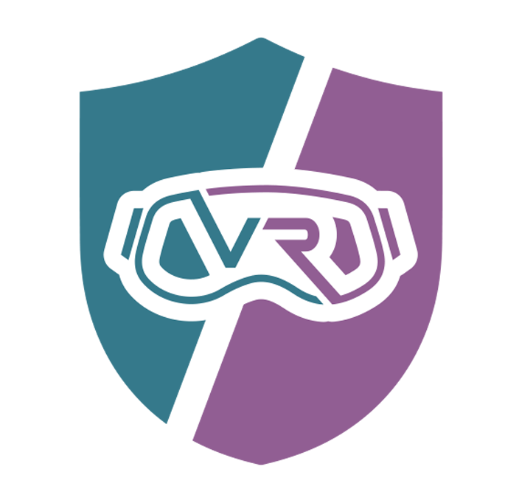
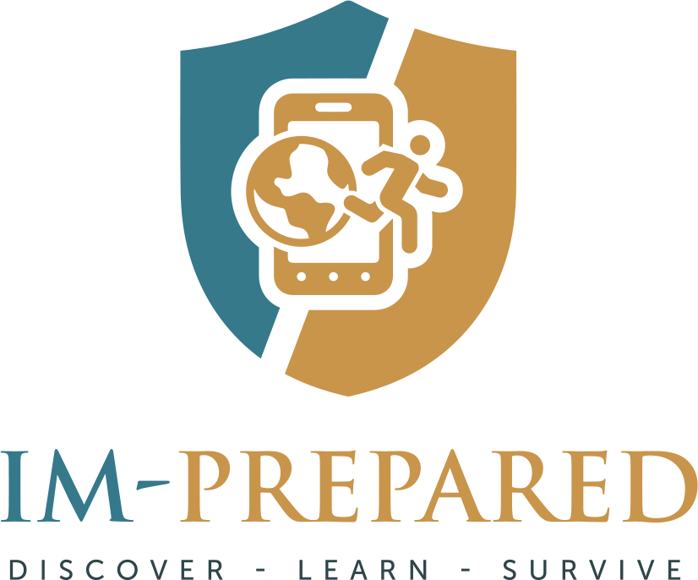

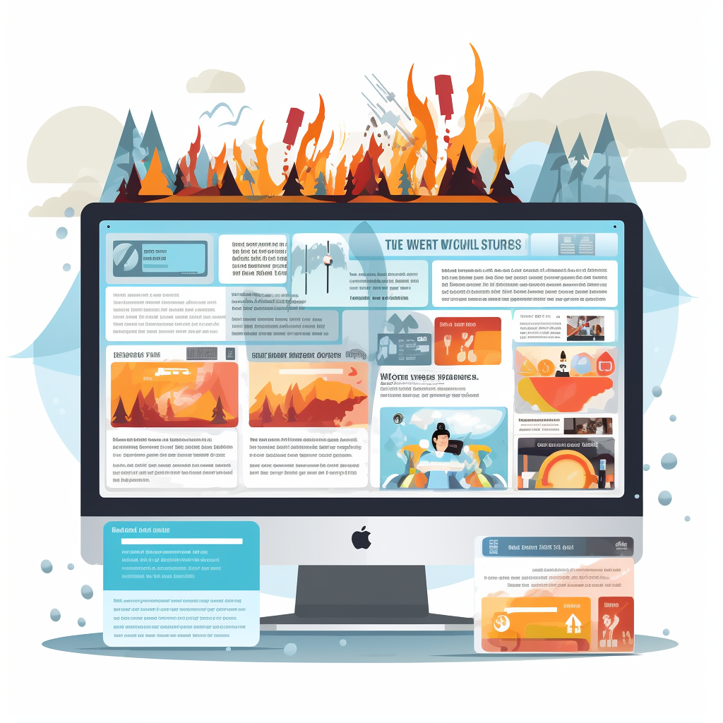

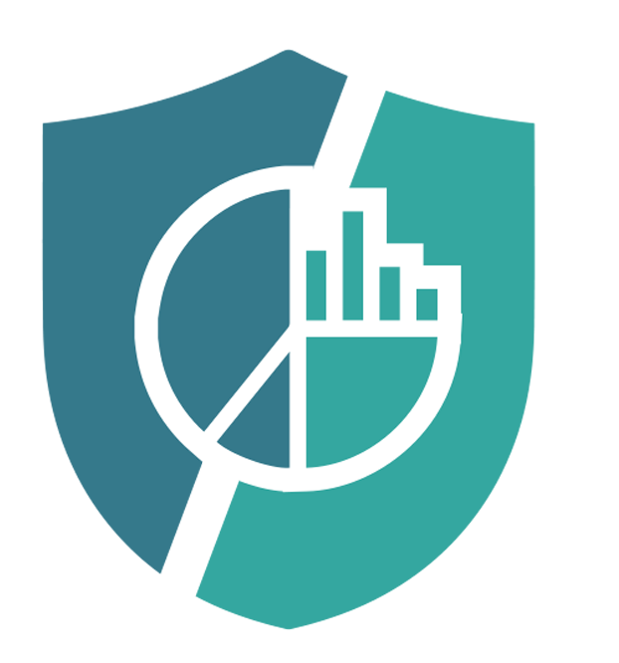
B-prepared ecosystem
VR-PREPARED
Virtual Reality serious game for the safest near-real experience
IM-PREPARED
Gamified geocaching mobile app for the widest possible reach
DISASTROPEDIA
Knowledge Management System about
disasters
RU-PREPARED
Learning Management System to measure progress across all types of applications

Slide 6





IM-prepared - product goal and statistics
To develop gamified mobile application called “IM-prepared” teaching disaster preparedness, providing location-sensitive preparedness-related content in digital walks in different roles.
18,450 18 45 29 7
app downloads walks walk versions mini games AR scenarios

Slide 7
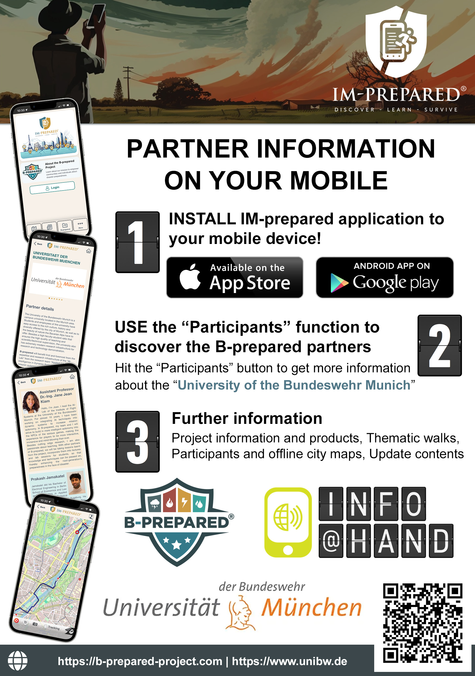


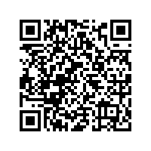
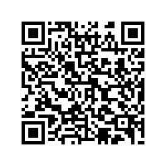
Download the app

Slide 8





IM-prepared components
Disaster preparedness content is provided through free, downloadable multimedia packages called “walks”.
Walks may consist of several multimedia components:
POIs (enriched with multimedia content such as texts, figures, movies, voices, links, etc.),
Navigation instructions,
Mini games,
AR games,
Routes,
Interactive maps.

Slide 9
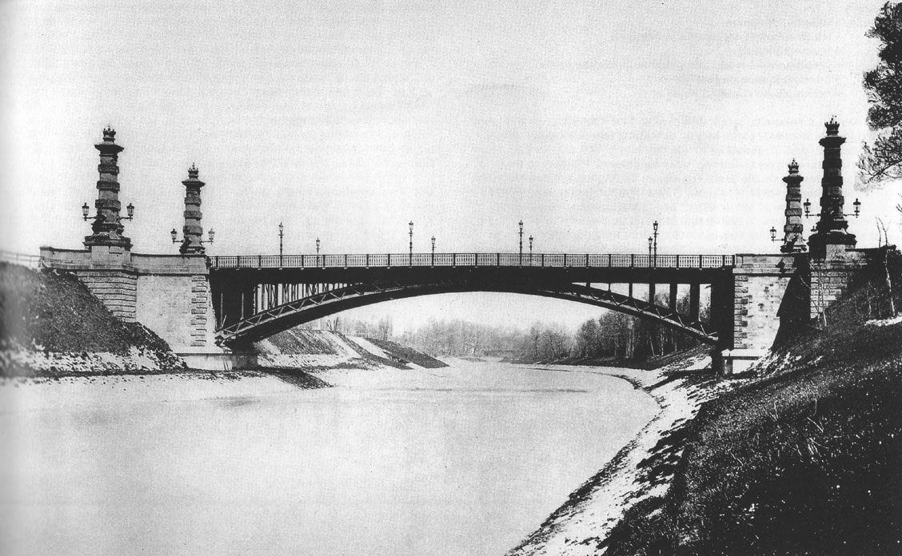
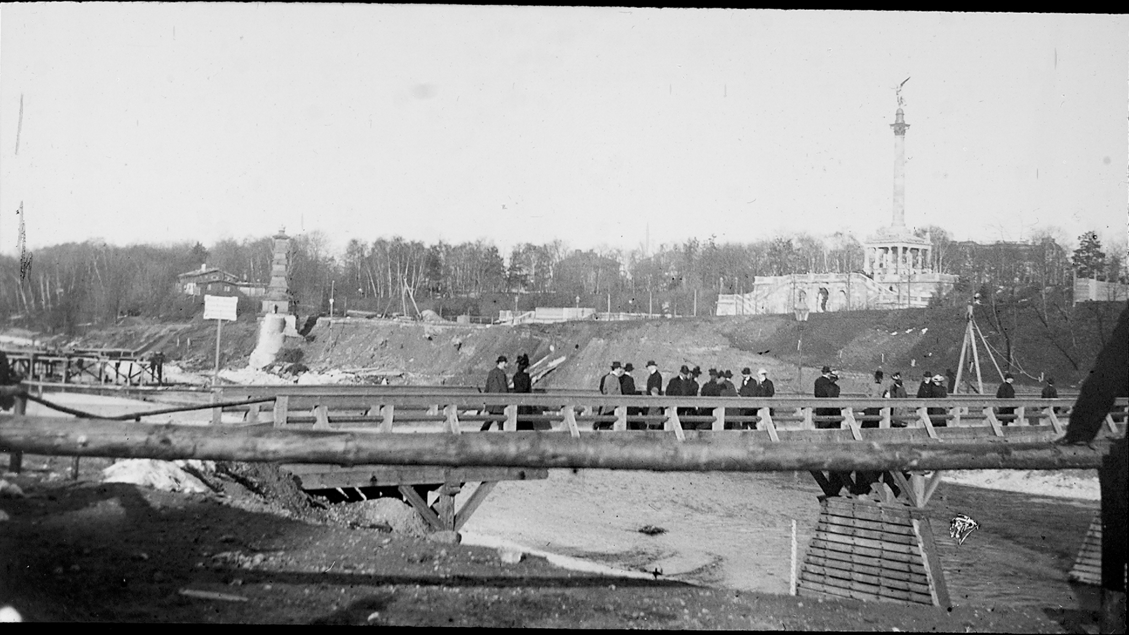
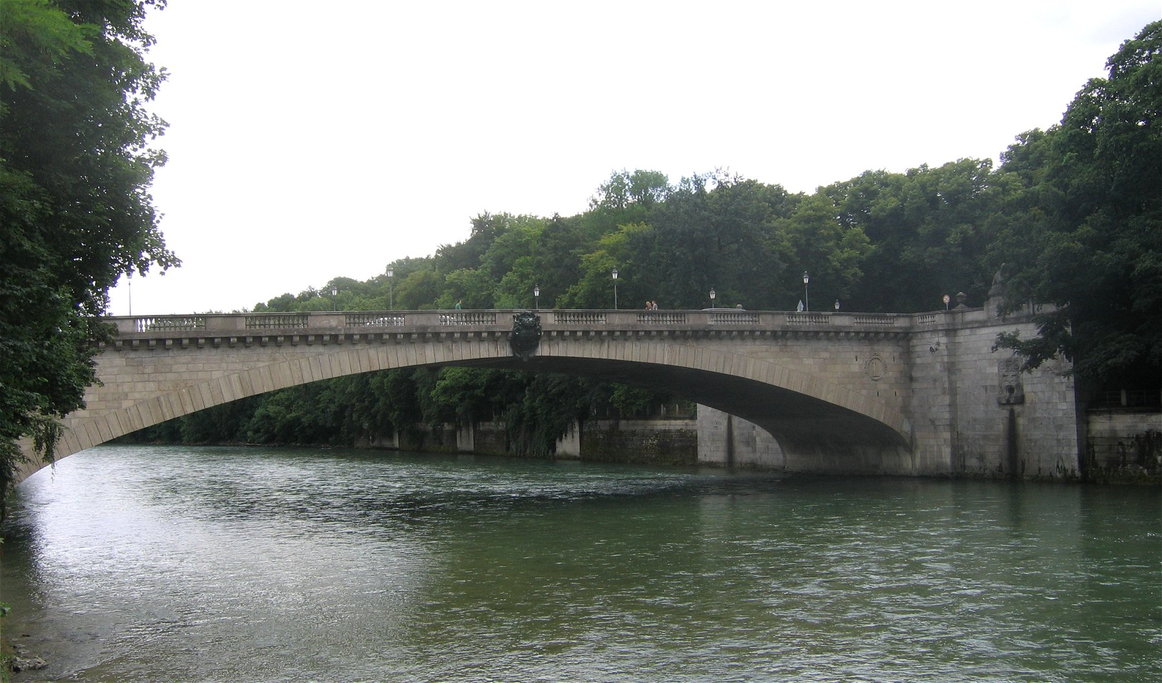
Munich’s Thematic Heritage Sites along the Isar
Max-Joseph Bridge / Bogenhausen Bridge,
Emergency Bridge Bogenhausen,
Luitpold Bridge,
Maximilianswerk Hydropower Plant,
Museum Island,
Reichenbach Bridge,
Wittelsbach Bridge,
Isar River Restoration.
original bridge
after the 1899 flood
emergency bridge
new bridge

Slide 10
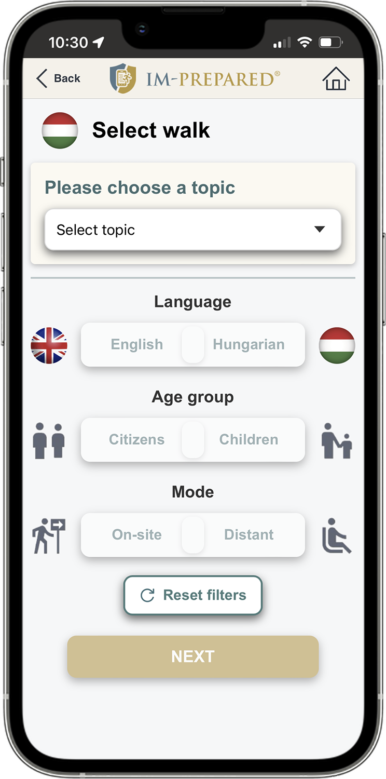
Walk versions
Walks may have different versions according to language, role and mode.
Walks can be available in English and/or local language.
Two roles are available based on age group:
Citizens - general walk version targeting all age groups.
Children - for ages 11-14.
Two modes are available: on-site, distant.

Slide 11
Walk modes
Guided mode
navigate you along a predefined route supported by an interactive map;
have a starting point, indicated by a flashing blue circle on the map;
contain POIs and navigation instructions;
recommended for on-site use;
need to use the location service (GPS) running on your device;
are not available for all walks.
List-based mode
help to explore the POIs by selecting them from a list in any order;
do not have a starting point;
do neither contain a route nor navigation instructions;
are primarily recommended for remote use (Distant mode);
can also be used on-site, preferably with GPS support;
are available for all walks.

Slide 12
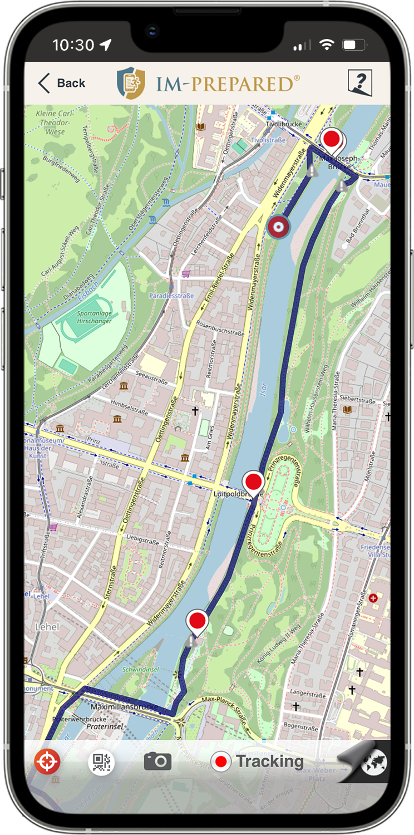
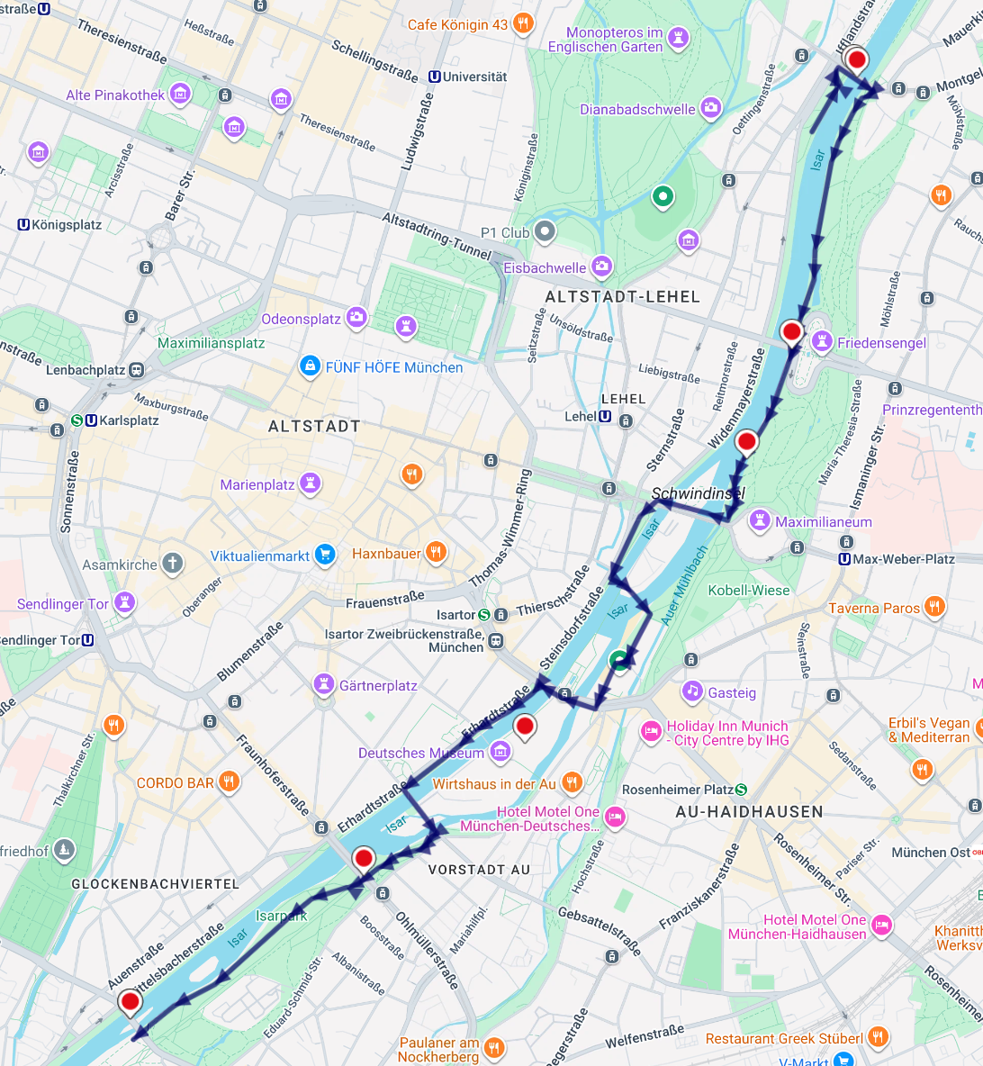
“1899 Isar Flood in Munich” walk map

Slide 13
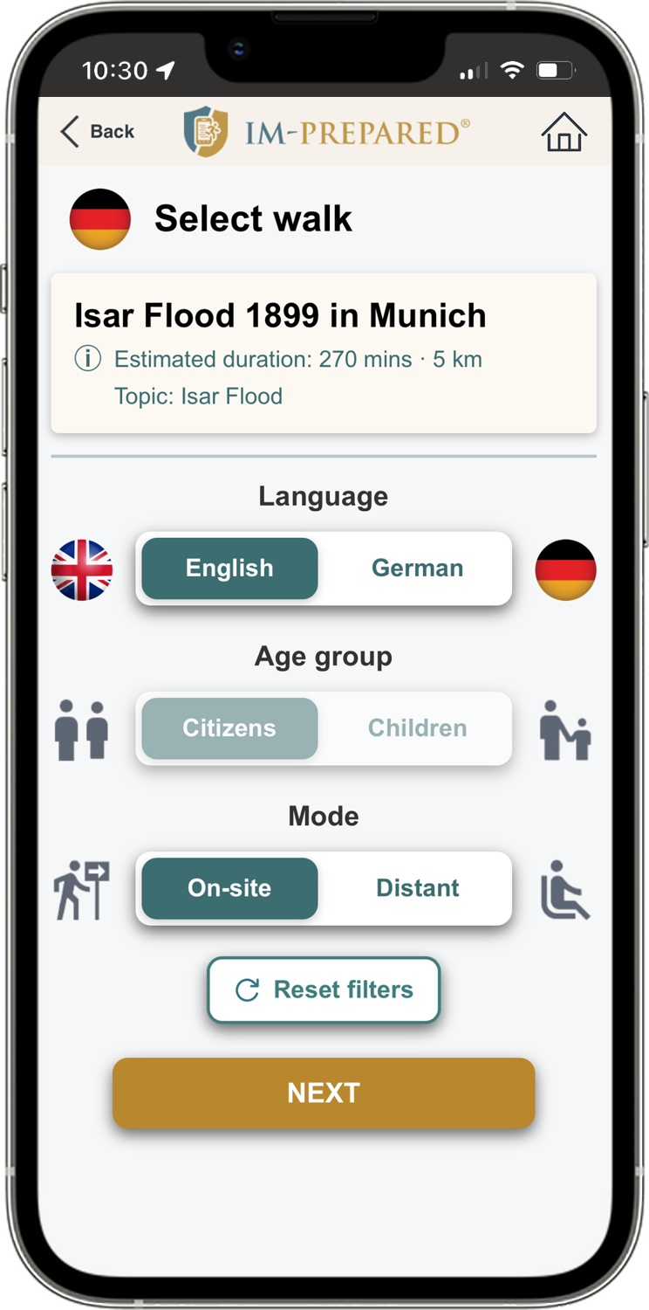
“1899 Isar Flood in Munich”
Walk versions (language, role, mode):
English, Citizens, On-site,
English, Citizens, Distant,
German, Citizens, On-site,
German, Citizens, Distant.

Slide 14
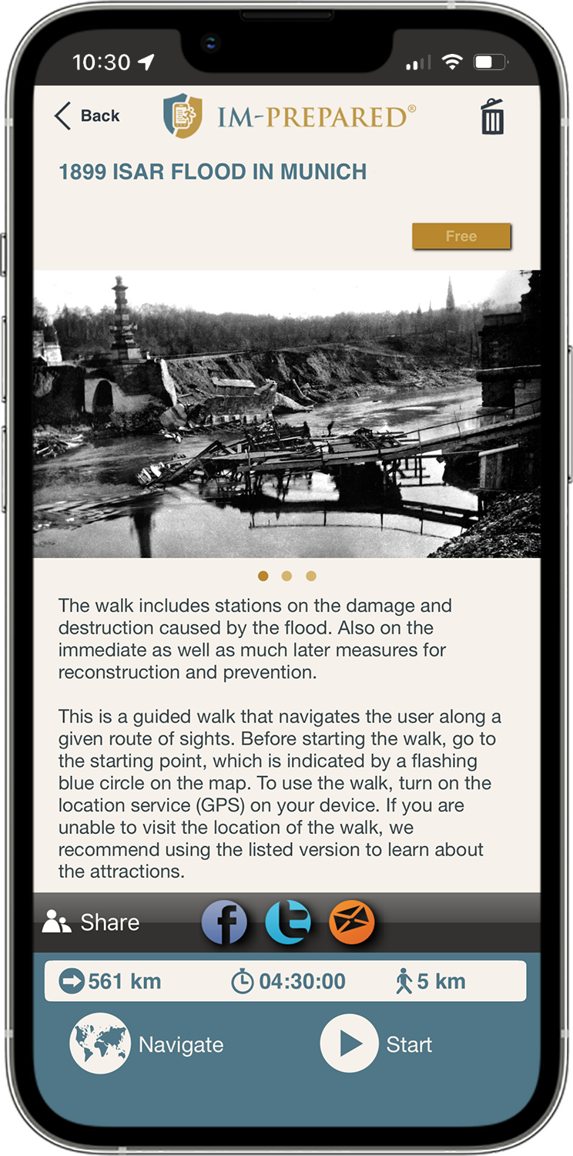
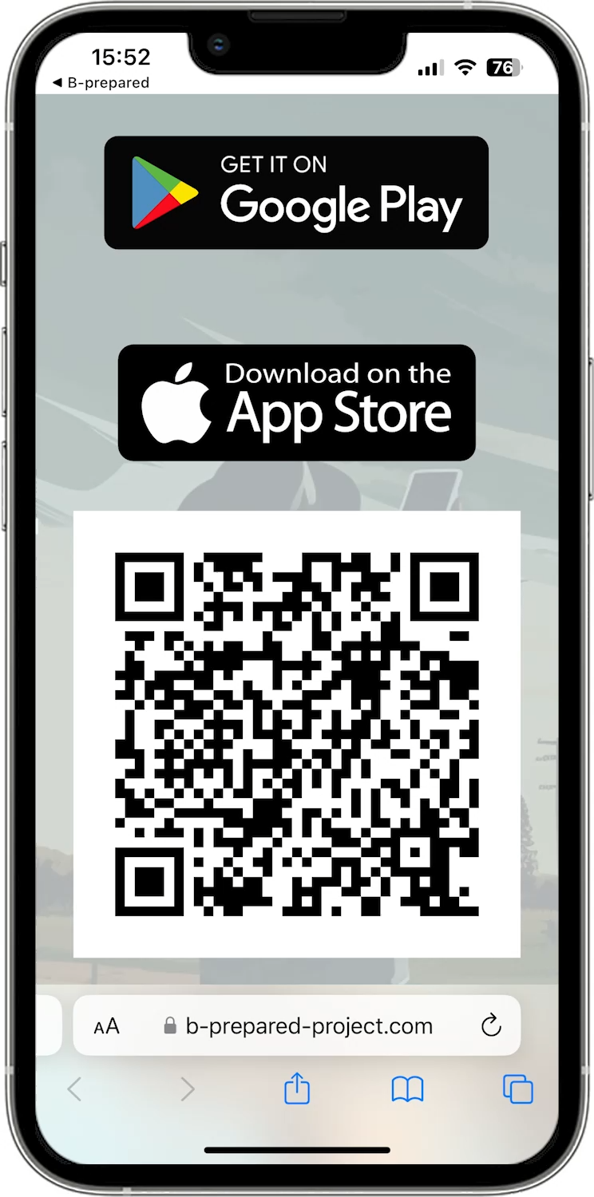
Walk demo
video

Slide 15
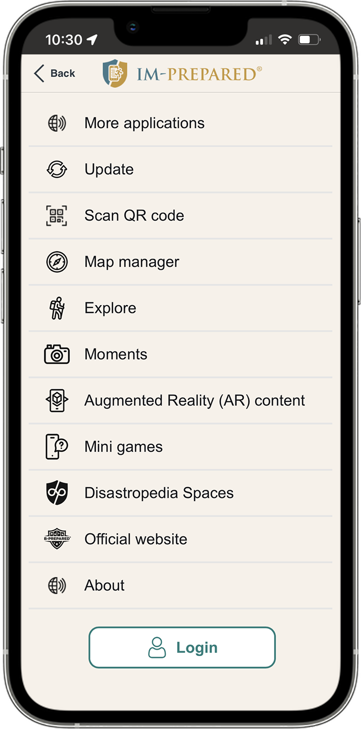
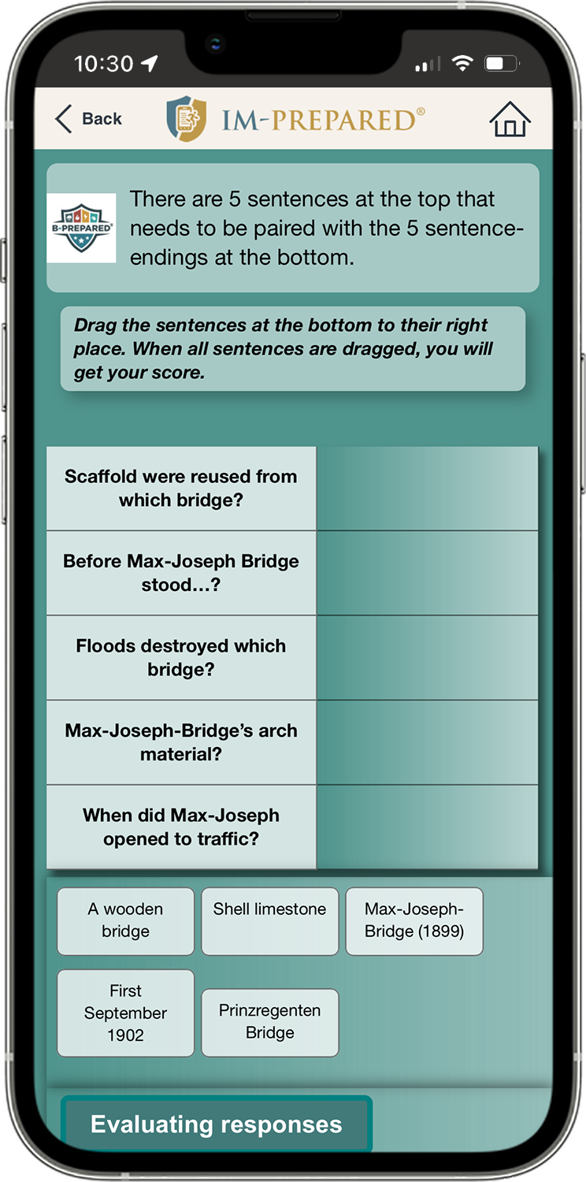
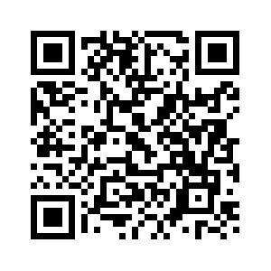
Minigames
Game testing

Slide 16
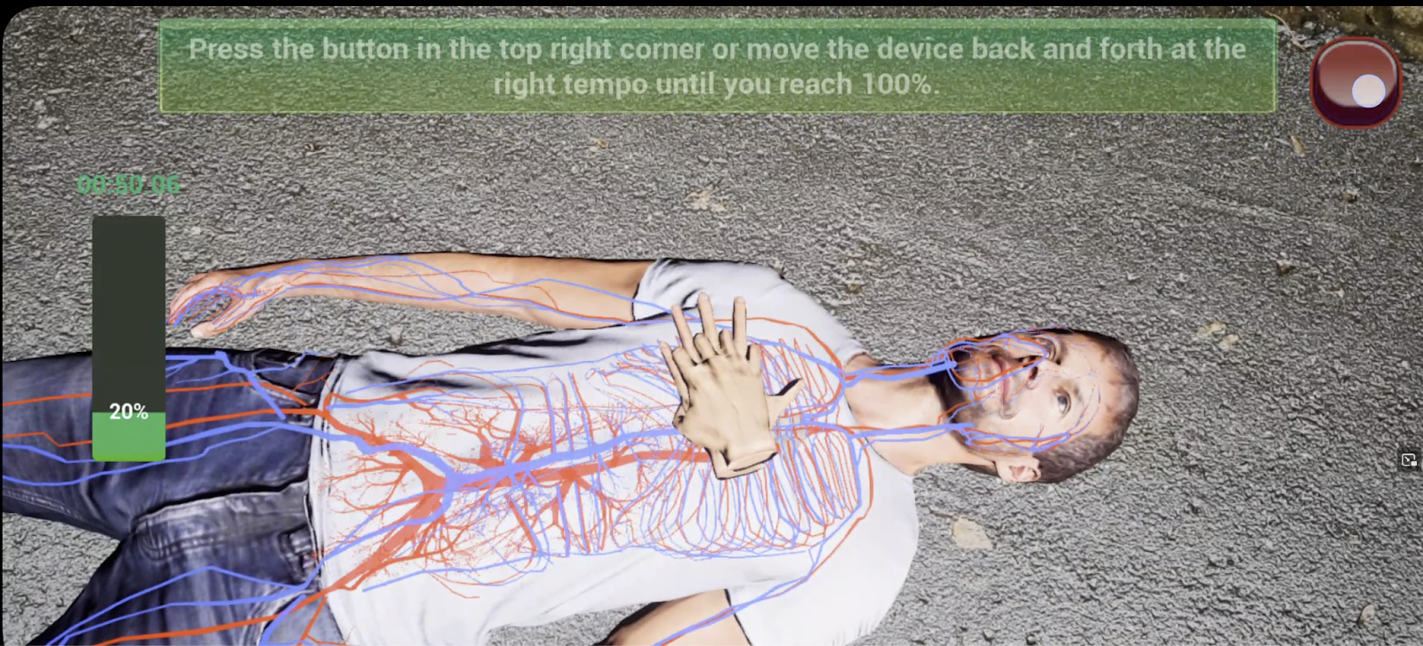
AR simulation
Cardiopulmonary Resuscitation (CPR)
Languages: EN, FR, HU, DE, NO

Slide 17
Evaluation
User ratings of overall satisfaction with the IM-prepared application

Slide 18
Conclusions and future work
We presented the “1899 Isar Flood in Munich” gamified mobile walk.
The primary aim of the walk development was to help civilians learn about the preparedness needed to manage floods.
The walk also presents the cultural, historical and architectural values of Munich bridges.
We are ready to co-operate with new partners to extend the IM-prepared application with further gamified mobile walks.

Slide 19
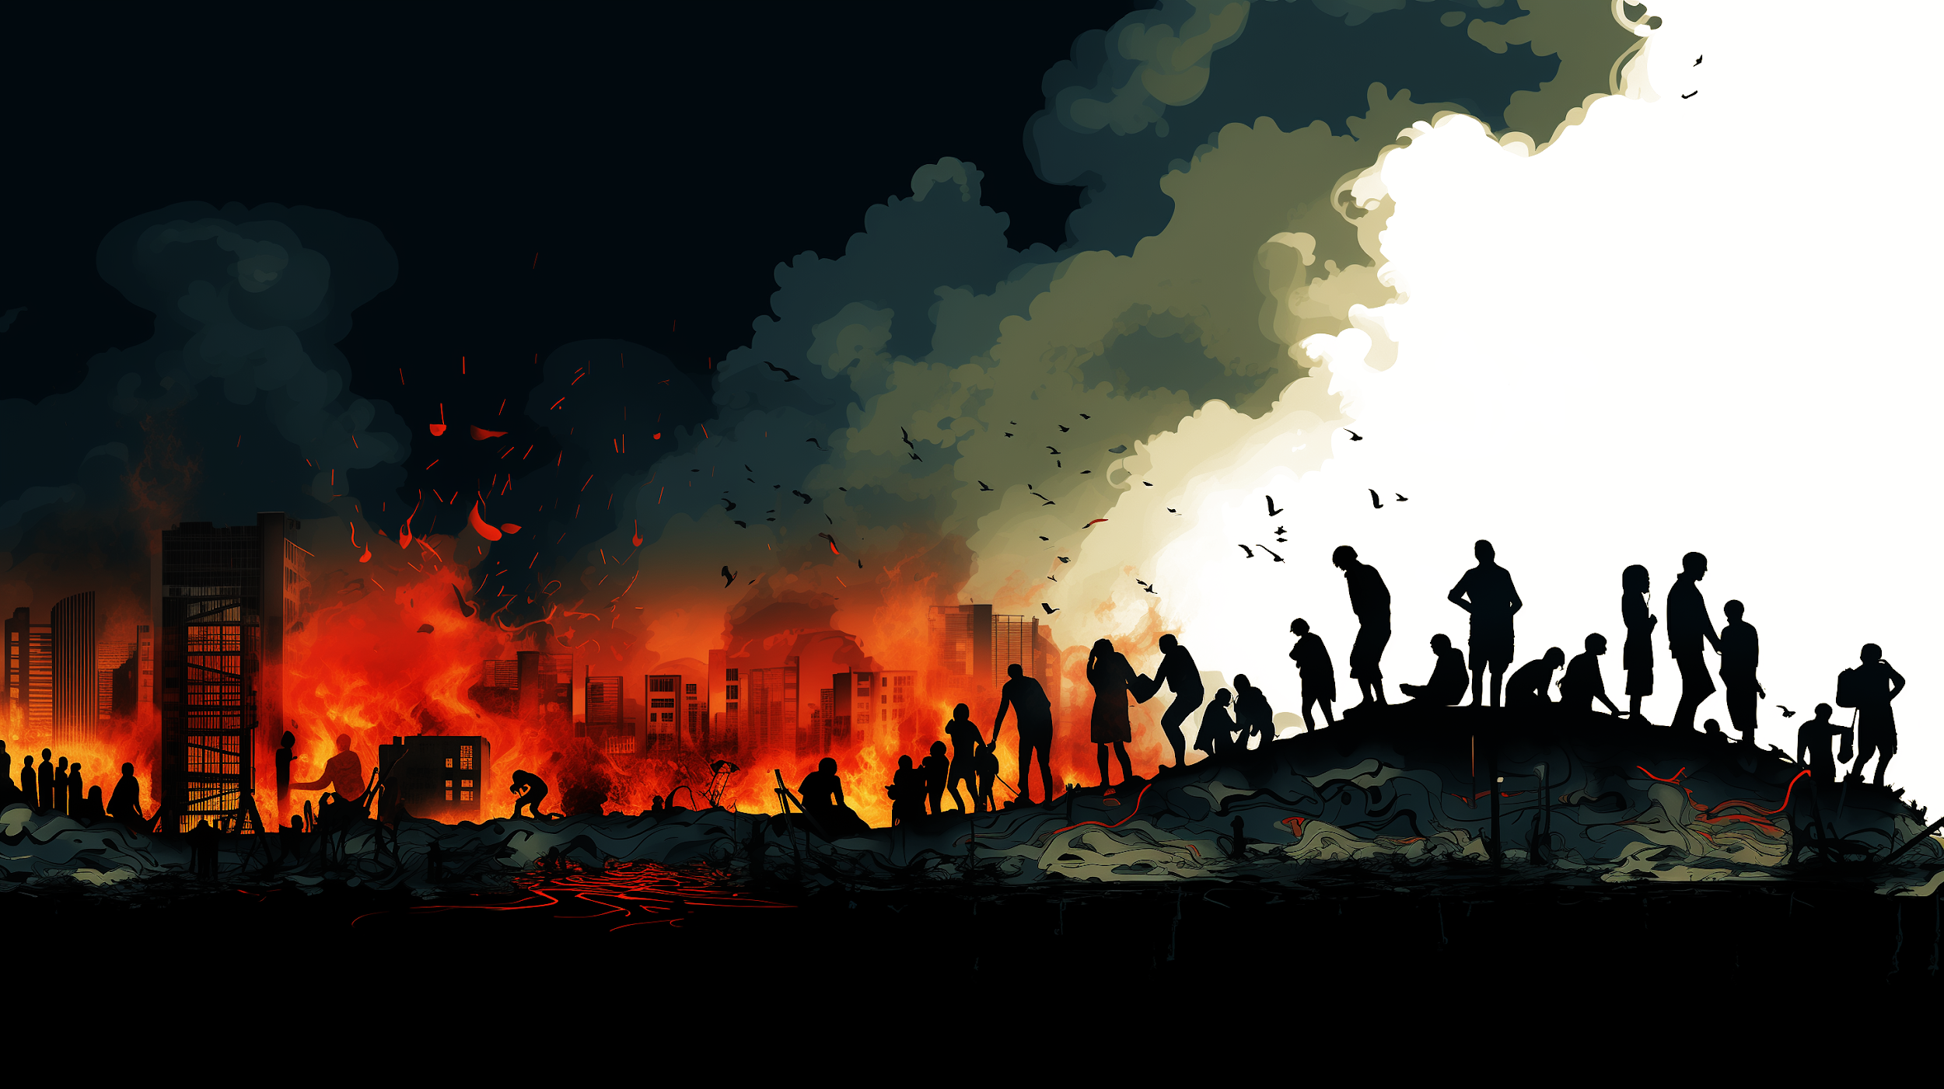
THANK YOU FOR YOUR
ATTENTION!
Zsolt László MÁRKUS
HUN-REN SZTAKI
DiPP 2026 Conference
September 24–27, 2026, in Burgas, Bulgaria

